Slide 1
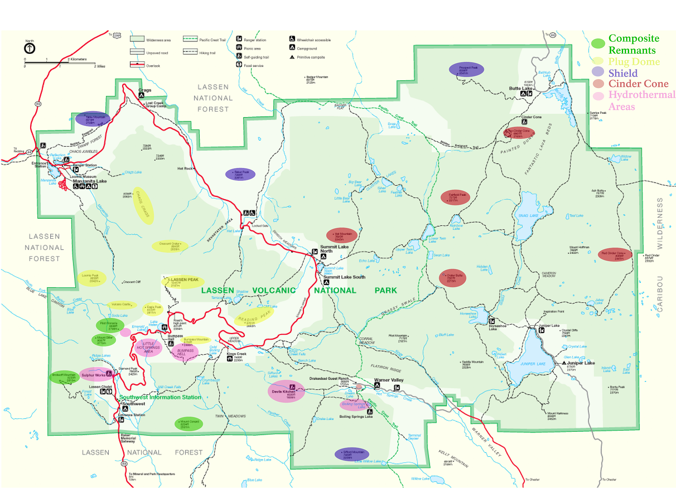
Notes:
Containing multiple examples of all four fundamental types of volcanoes, Lassen Volcanic National Park is aptly named.

Slide 2
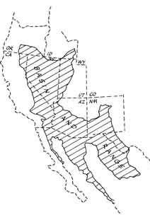
Lassen Volcanic
Notes:
Part of the reason for Lassen’s volcanic diversity has to do with the fact that, like Crater Lake, Lassen Volcanic National Park falls within a portion of the Cascade Range that lies on the northwestern edge of the Basin and Range. Because Cascadian volcanoes will typically erupt an intermediate magma characteristic of subduction zones and Basin and Range volcanoes will typically erupt bimodal (mafic/felsic) magma, the full spectrum of magma types is produced here.

Slide 3
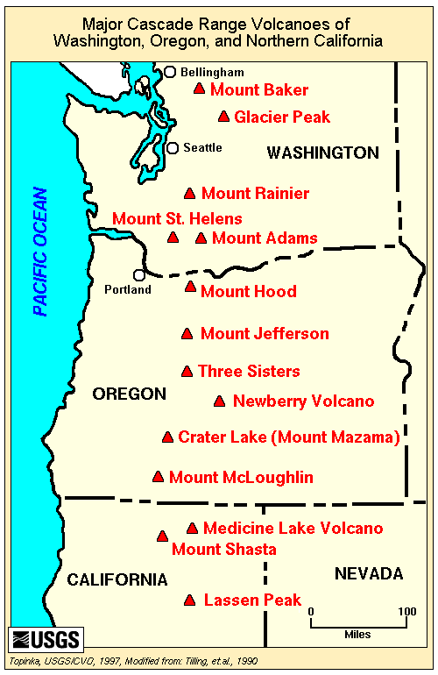
Notes:
Located at the southernmost end of the Cascades, …

Slide 4
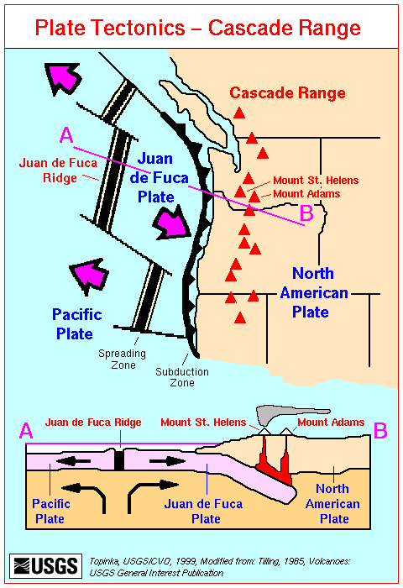
Slab window
Notes:
… Lassen is positioned to not only receive magma generated from the subduction of the Juan de Fuca Plate and Basin and Range extension, but magma could also be produced due to the proximity of the slab window just to the south of the park.

Slide 5
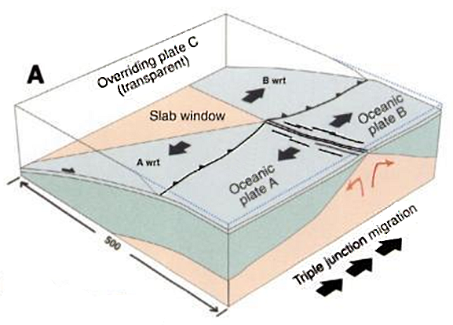
Slab windows
Notes:
We discussed slab windows in the lesson on Kenai Fjords National Park. Remember that they form due to the fact that oceanic crust can no longer be made at an ocean ridge if that ridge is subducted. The continuing subduction of the older oceanic crust away from the ridge combined with the lack of new oceanic crust produced at the ridge, results in a gap between the two subducting plates called a slab window. Slab windows bring the hot asthenosphere in contact with the base of the continental lithosphere which can result in partial melting of the silica-rich continental rocks.

Slide 6
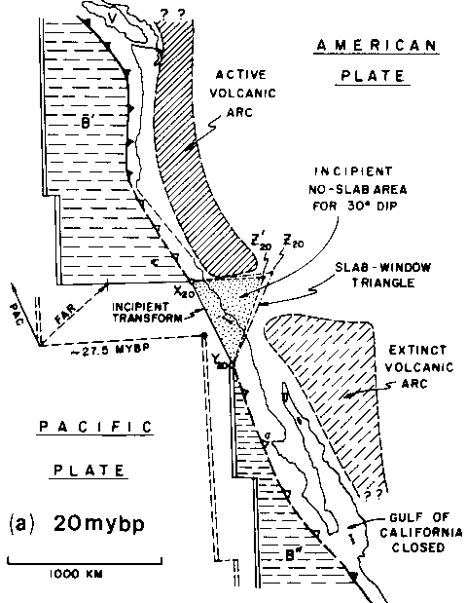
Notes:
The slab window under California, Nevada and Baja developed as progressively more of the Pacific Plate encountered the edge of North America.

Slide 7
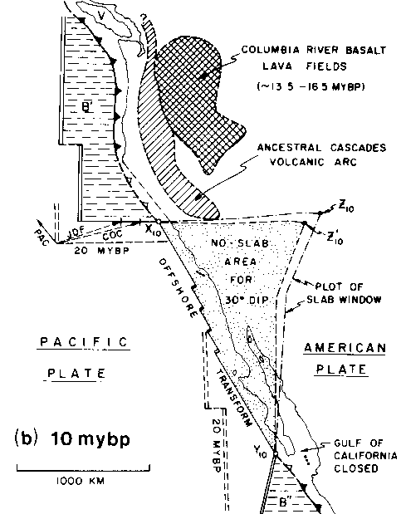
Notes:
As the subducting plate continued to slide away from the trench, and no new oceanic lithosphere was made to replace it, the slab window grew …

Slide 8
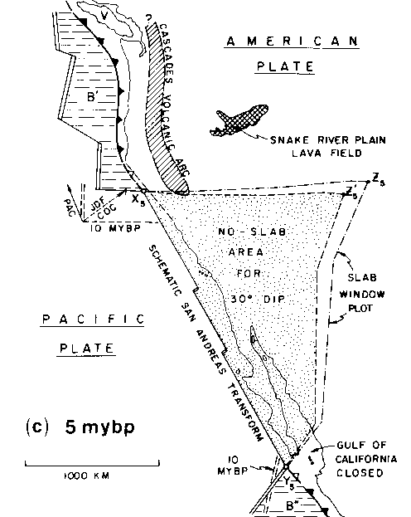
Notes:
… while the Cascadian Volcanic Arc shortened.

Slide 9
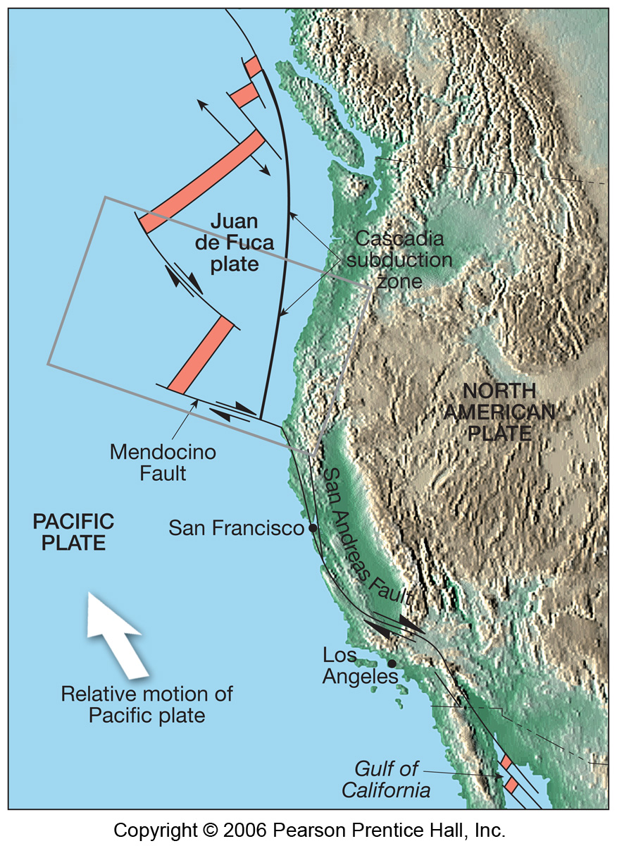
Lassen Volcanic
Slab Window
Notes:
Today the northern edge of the window lies just south of Lassen Volcanic National Park, making it entirely possible that hot asthenosphere has welled-up under the park and contributed to the volcanic diversity.

Slide 10
Notes:
A complete account of the park’s entire spectrum of volcanic landforms is not he goal of this lesson. Instead we shall focus on the eruptive history of the park’s tallest volcano and namesake – Lassen Peak, as it was closely observed and serves as a fine example of the variety of volcanic hazards possible in the Cascades.

Slide 11
Dacite dome
Notes:
The bulk of Lassen Peak is a large volcanic dome (=plug dome) made almost entirely of dacite. Dacite is a high-silica volcanic rock which solidifies from lava that is too viscous to flow away from the vent. Lassen Peak has the distinction of being the largest volcanic dome in the world.

Slide 12
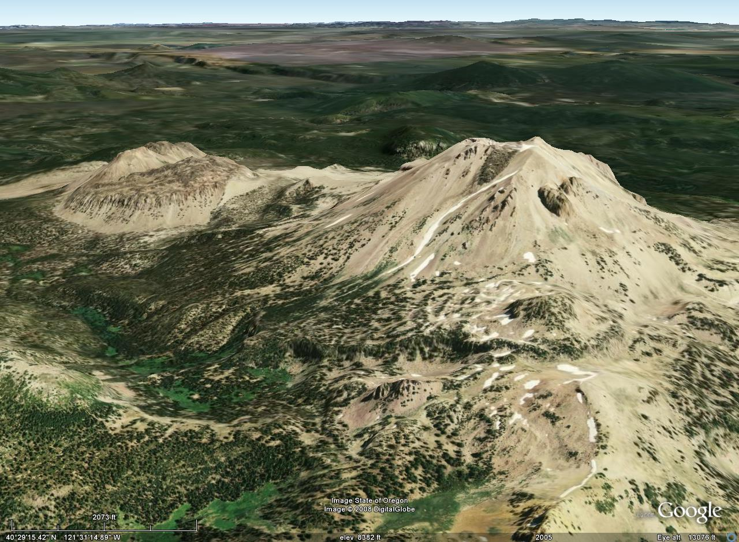
Chaos Crags
Lassen Peak
Notes:
The large dacite dome of Lassen Peak and several other domes, most notably those comprising Chaos Crags, were formed …

Slide 13
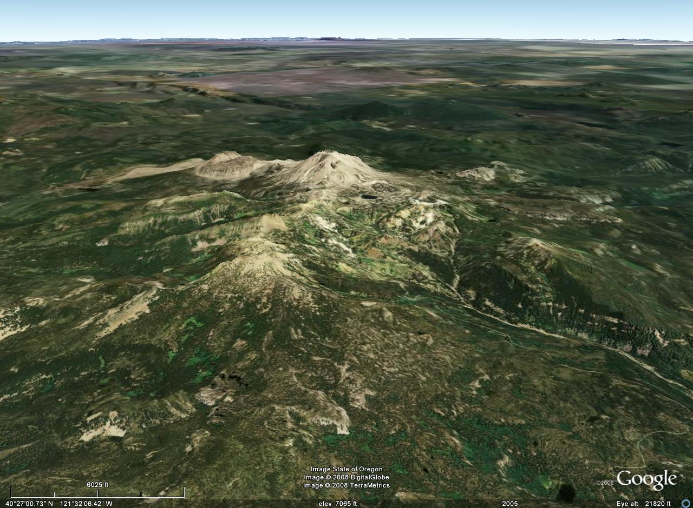
Former location of Mt. Tehama
Notes:
… on the flanks of a now extinct and highly eroded composite volcano, known as Mt. Tehama.

Slide 14
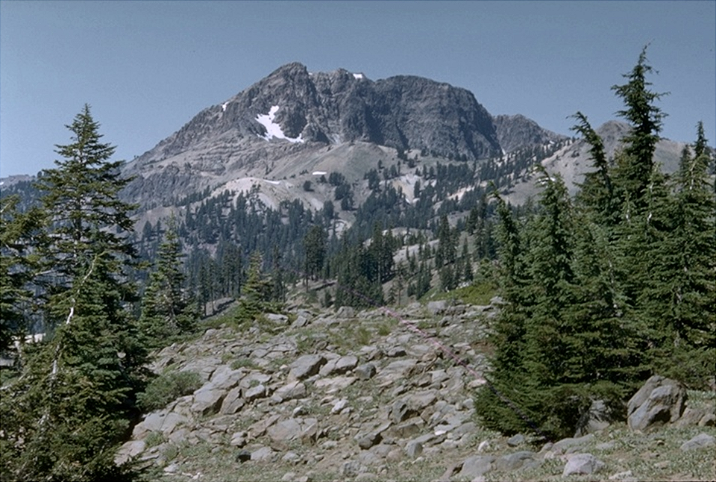
Brokeoff Mountain (Mt. Tehama remnant)
Notes:
The remnants of Mt. Tehama are seen as several scattered peaks south of Lassen Peak. Most notable of these is Brokeoff Mountain, which quite literally was broke off of Mt. Tehama.

Slide 15
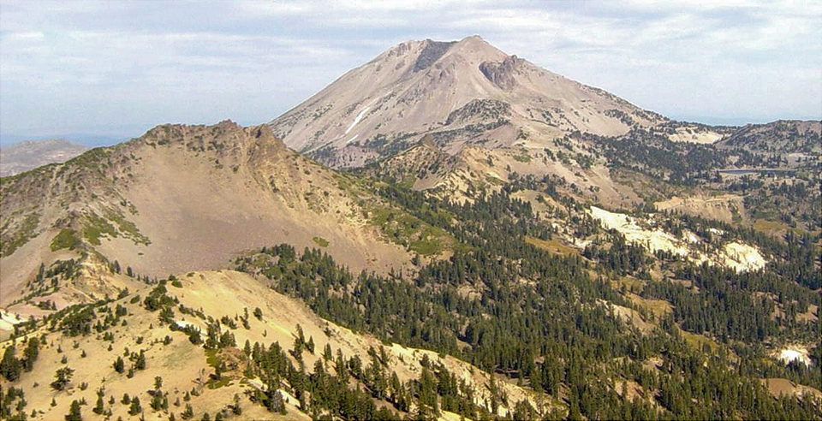
More remnants of Mt. Tehama
Mount Dillar
Pilot Pinnacle
Notes:
Looking northeast from the summit of Brokeoff Mountain towards Lassen Peak in the background you can see more remnants of Mt. Tehama, now as Mt. Dillar and Pilot Pinnacle.

Slide 16
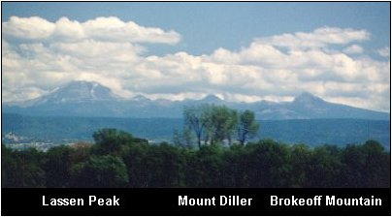
Notes:
Viewed from a distance, it is tantalizing to project the slopes of Lassen Peak and Brokeoff Mountain upward …

Slide 17
Notes:
… to form a gargantuan composite volcano well over 17,000 feet high.

Slide 18
Notes:
The reality is decidedly less spectacular. Mt. Tehama was probably only slightly higher than Lassen Peak.

Slide 19
History
Mt Tehama composite volcano built 600,000 to 400,000 years ago
Mt Tehama collapse(?) and erosion
Domes, glaciers and more domes
Most recent activity 1914-1921
Notes:
Although Mt. Tehama took a few hundred-thousand years to form, its demise was far more rapid, perhaps even instantaneous.

Slide 20
PROJECTED HEIGHT OF MT TEHAMA
MOUNT LASSEN
BROKEOFF MOUNTAIN
Notes:
If you had visited this area several thousand years ago, Mount Tehama would have risen to 11,000 or so feet before you, stretching from what is now the base of Mount Lassen to Brokeoff Mountain. There are at least three theories about what happened to Mount Tehama. According to the Lassen Volcanic National Park brochure, what happened to Mount Mazama in Oregon also happened to Mount Tehama. After growing for thousands of years, Mount Tehama erupted and collapsed. The difference is that Mount Tehama's caldera developed an outlet, so rain and snowmelt ran out instead of filling up the caldera. Other sources conclude that Tehama was eroded away by glaciers, while still others argue that hydrothermal alteration weakened Tehama so much that it could have largely have been removed by both glaciers and stream erosion. One of these versions, or perhaps a combination of the three, is probably correct.

Slide 21
History
Mt Tehama composite volcano built 600,000 to 400,000 years ago
Mt Tehama collapse(?) and erosion
Domes, glaciers and more domes
Most recent activity 1914-1917
Notes:
Starting about 50,000 years ago and continuing sporadically until about a thousand years ago at least 30 domes grew on the slopes of the then mostly eroded Mt. Tehama. During this time, the Wisconsin glacial period, occurring between 38,000 and 11,000 years ago, greatly affected the older domes.

Slide 22
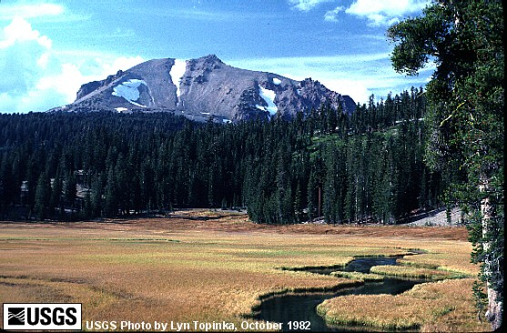
The great dacite dome of Lassen Peak
25,000 - 31,000 years old
Notes:
The great dacite dome of Lassen Peak was pushed up from pre-Lassen dacites sometime between 25,000 and 31,000 years ago. Since this took place while the area was glaciated …

Slide 23
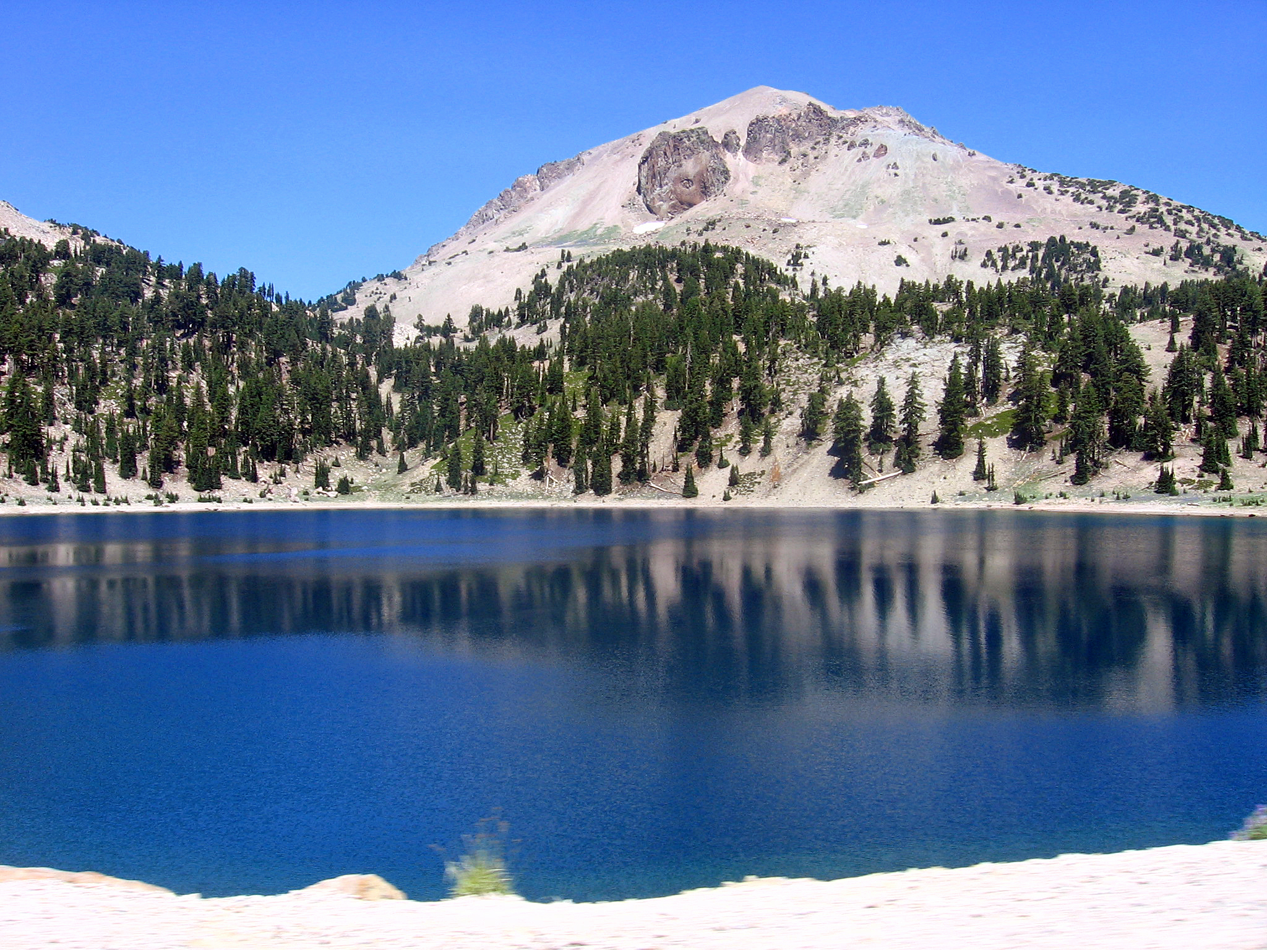
Talus
Notes:
… the shape of the original dome has been highly modified by glacial erosion and talus covers much of Lassen’s slopes. The lake in the foreground is Lake Helen, whose deep blue color …

Slide 24
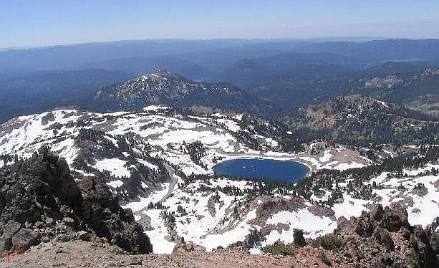
Lake Helen: Filled crater, caldera or cirque?
Notes:
… and circular shape is reminiscent of Crater Lake. So what do you think? Is this a water-filled crater, caldera or cirque? Here’s a hint: We’re talking about the effects of glaciation right now.

Slide 25
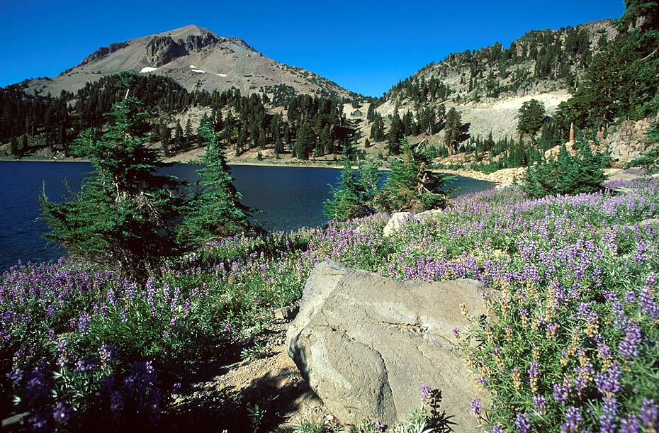
Lake Helen fills a cirque
Notes:
That’s right, it fills a cirque. Now what do you call a lake that fills a cirque? Hint: We saw several of these in Great Basin National Park.

Slide 26
Tarn
Notes:
If said tarn, you’ve got a great memory and/or an uncommon interest in glacial landforms. Personally, I think volcanoes are far more fascinating, so even though there are many other glaciated features in the park, we’re pretty much going to ignore them and stay focused on volcanism.

Slide 27
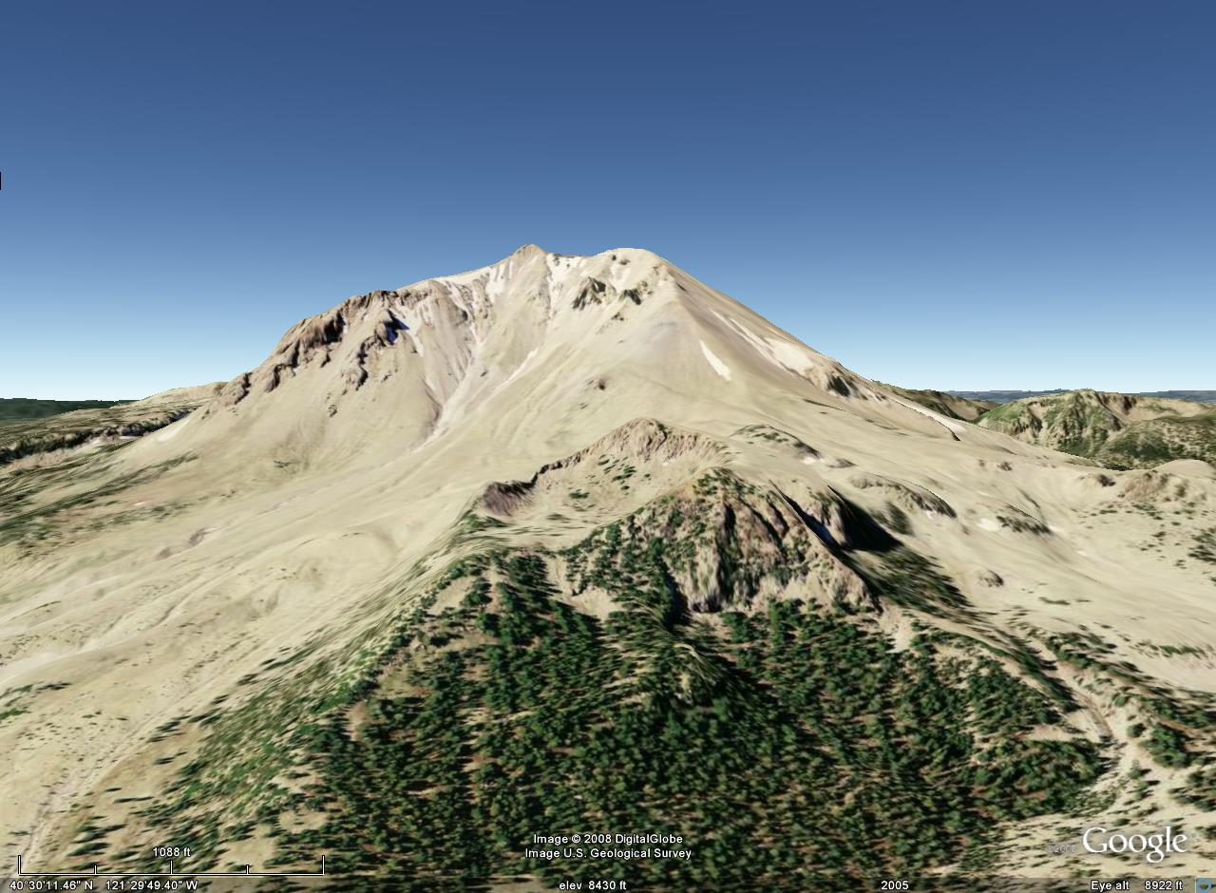
Crescent Crater
Notes:
So getting back to the volcanic story, dome building took place before, during and after the Wisconsin glacial period. Crescent Crater, on the northeast slopes of Lassen Peak is an example of one of the many domes that erupted after the great dome of Lassen Peak formed. The crater formed as the still molten interior of the dome sank back into the vent. Like Lassen Peak, this dome’s shape is muted by glacial erosion - indicating that both formed before the end of the Wisconsin glacial period.

Slide 28
Chaos Crags
Lassen Peak
Notes:
Chaos Crags, on the other hand, …

Slide 29
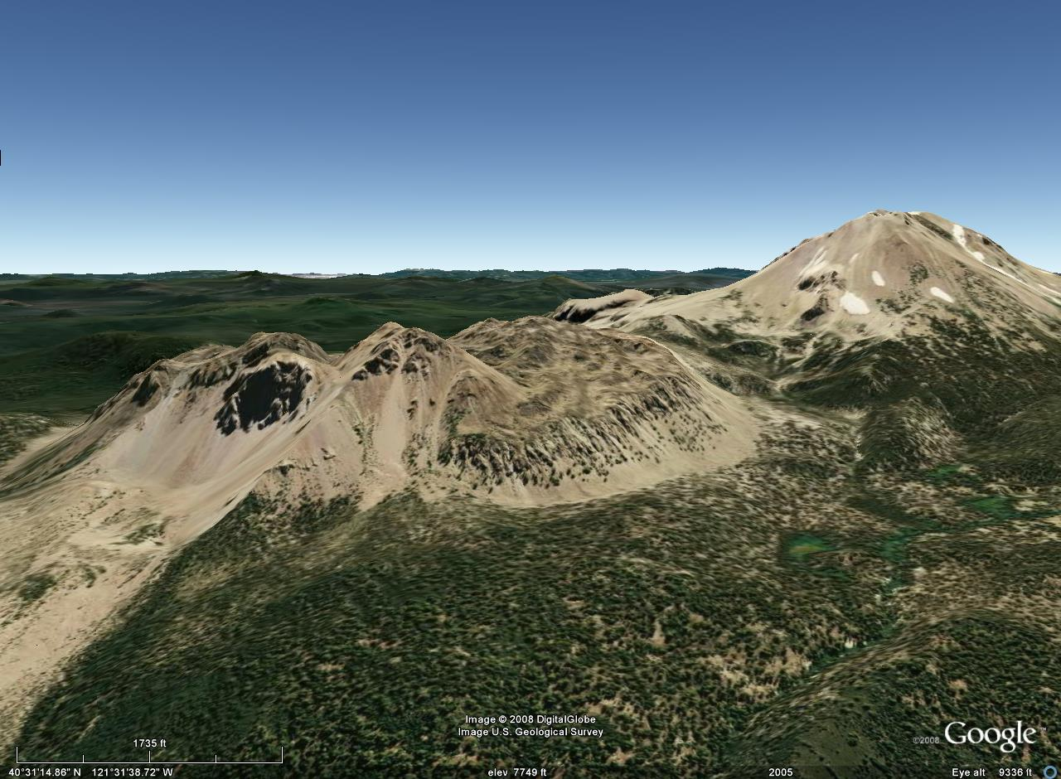
Lassen Peak
Chaos Crags
Notes:
… is a complex of at least four domes that formed only about 1,100 years ago – well after the glacial ages had ended. It therefore retains the extremely steep slopes characteristic of domes, although a fair amount of non-glacially derived talus covers their lower slopes. Such talus forms from the expansion, fragmentation and gravitational collapse of the dome’s solidified exterior as magma is added to the dome’s interior.

